Slide 1
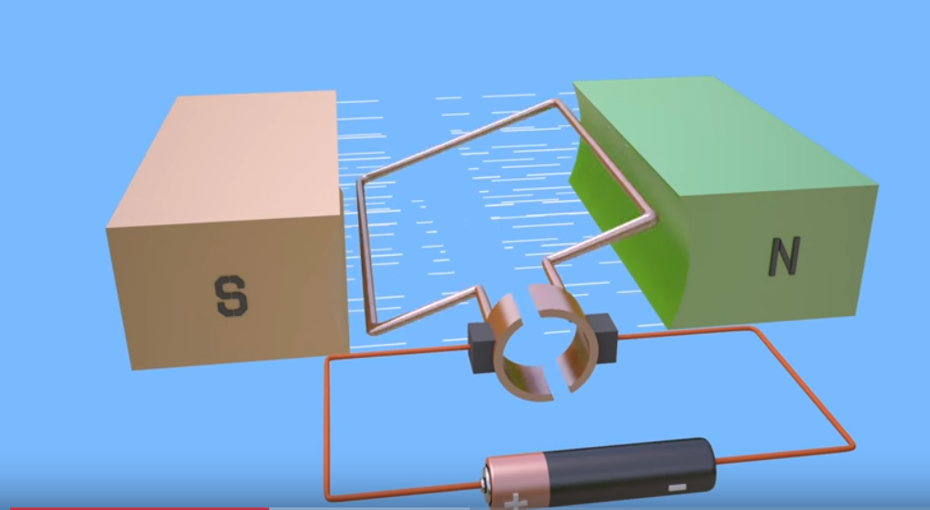
DC MOTOR THEORY OF OPERATION
A motor is an electrical machine which converts electrical energy into mechanical energy.
Take a wire and put it between the poles of a powerful, permanent horseshoe magnet.
Connect the two ends of the wire to a battery, the wire will move briefly.
When current pass through, it creates a magnetic field around it.
If we place the wire near a magnet, this magnetic field interacts with the permanent magnet's field.
It’s like putting two magnets near one another, they will repel or attract.
In the same way, the temporary magnetism around the wire attracts or repels the permanent magnetism from the magnet, and that's what causes the wire to move.
https://www.youtube.com/watch?v=j_F4limaHYI

Slide 2
DC MOTOR THEORY OF OPERATION
The principle of working of a DC motor is that "whenever a current carrying conductor is placed in a magnetic field, it experiences a mechanical force".
Magnetic field may be provided by field winding (electromagnetism) or by using permanent magnets.
https://www.electricaleasy.com/2014/01/basic-working-of-dc-motor.html

Slide 3
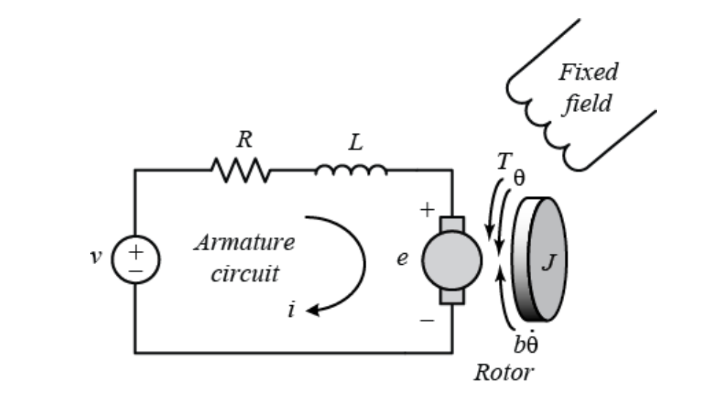
DEVELOP A DC MOTOR MODEL
The electric circuit of the stator and the free-body diagram of the rotor are as shown
http://ctms.engin.umich.edu/CTMS/index.php?example=MotorPosition&section=SimulinkModeling

Slide 4
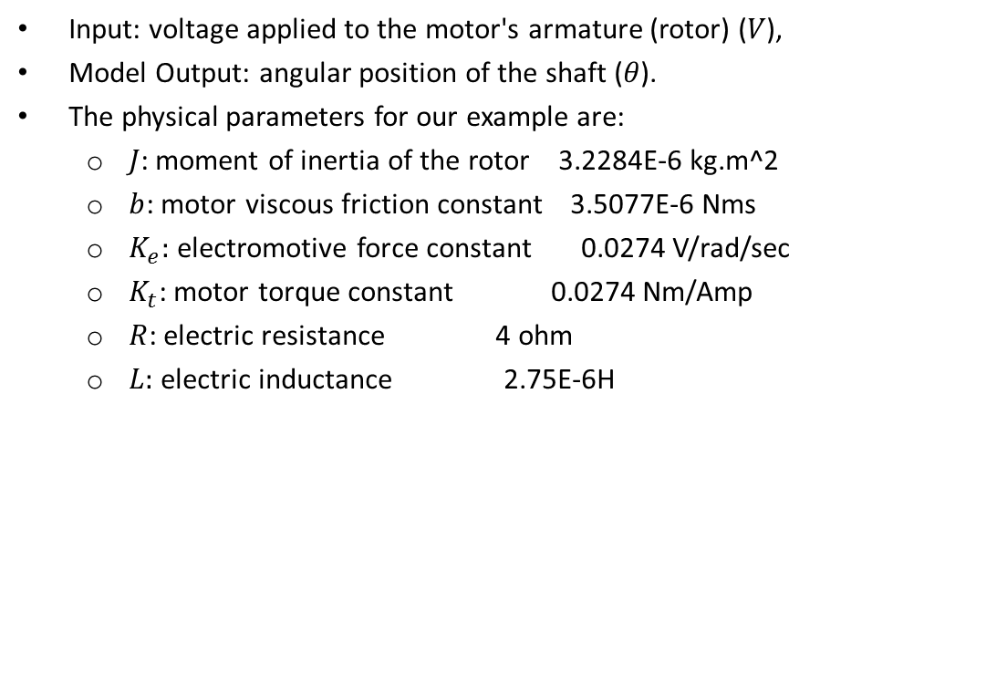
DEVELOP A DC MOTOR MODEL
Input: voltage applied to the motor's armature (rotor) ($V$),
Model Output: angular position of the shaft ($θ$).
The physical parameters for our example are:
$J$: moment of inertia of the rotor 3.2284E-6 kg.m^2
$b$: motor viscous friction constant 3.5077E-6 Nms
$K_{e}:$ electromotive force constant 0.0274 V/rad/sec
$K_{t}$: motor torque constant 0.0274 Nm/Amp
$R$: electric resistance 4 ohm
$L:$ electric inductance 2.75E-6H
http://ctms.engin.umich.edu/CTMS/index.php?example=MotorPosition&section=SimulinkModeling

Slide 5
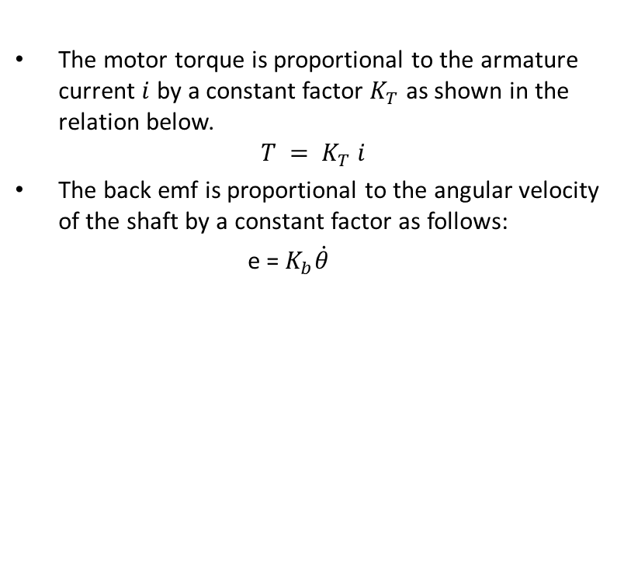
DEVELOP A DC MOTOR MODEL
The motor torque is proportional to the armature current $i$ by a constant factor $K_{T}$ as shown in the relation below.
$$T = K_{T} i$$
The back emf is proportional to the angular velocity of the shaft by a constant factor as follows:
e = $K_{b}\dot{θ}$
http://ctms.engin.umich.edu/CTMS/index.php?example=MotorPosition&section=SimulinkModeling

Slide 6
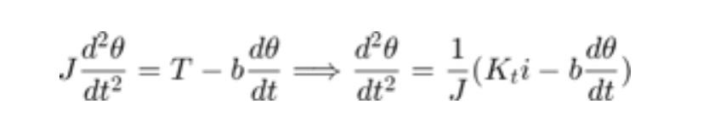
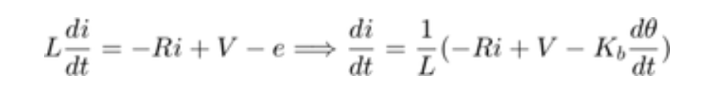
DEVELOP A DC MOTOR MODEL
Applying Newton’s second law:.
Applying Kirchhoff's law:
http://ctms.engin.umich.edu/CTMS/index.php?example=MotorPosition&section=SimulinkModeling

Slide 7
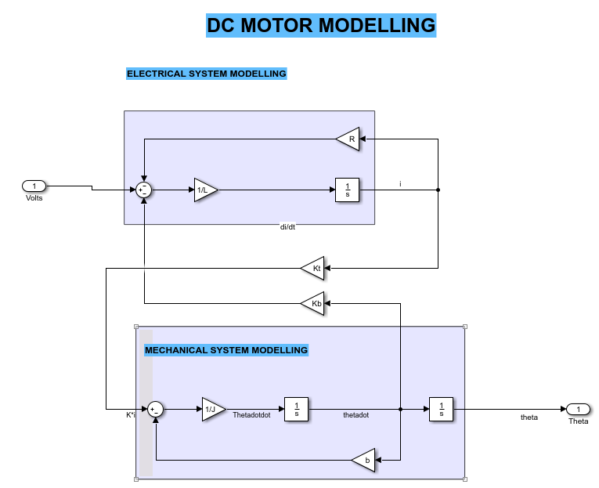
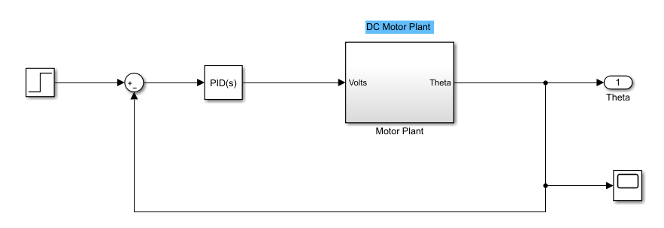
DC MOTOR MODEL

